Slide 1
Review for Exam 3
Operating Systems Theory

Slide 2
What is the minimum number of threads in a process?
1

Slide 3
True or False. Threads of the same process can share variables?
True

Slide 4
What is the blocking operation in the pthreads api?
pthread_cond_wait

Slide 5
What do threads use to signal other threads in the pthreads api?
condition variables

Slide 6
A ___________ is a piece of code that accesses a shared resource, such as a shared variable.
critical section

Slide 7
When multiple threads are running, and the output depends on the timing of their execution, then the code has a ___________.
race condition

Slide 8
How many condition variables are used in the Anderson/Dahlin method?
0 or more

Slide 9
At most one thread at a time can be in the critical section – this is __________.
mutual exclusion

Slide 10
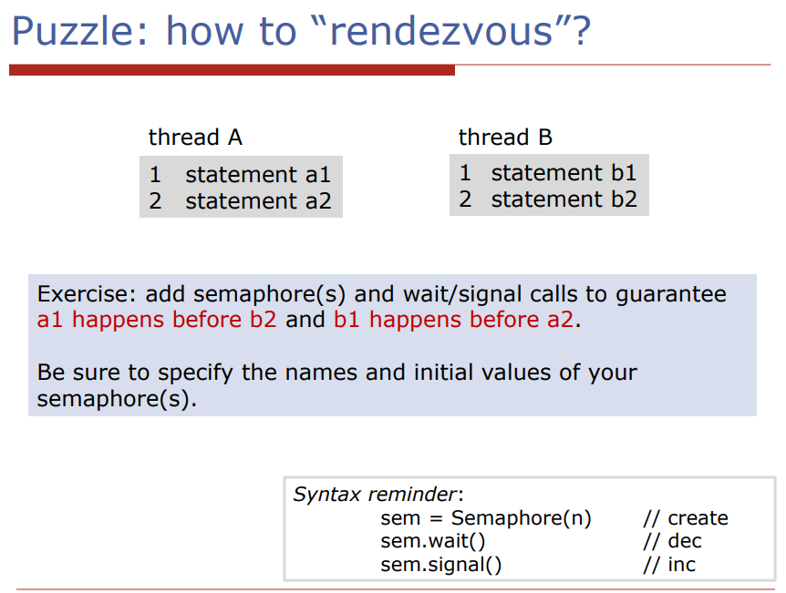

Slide 11
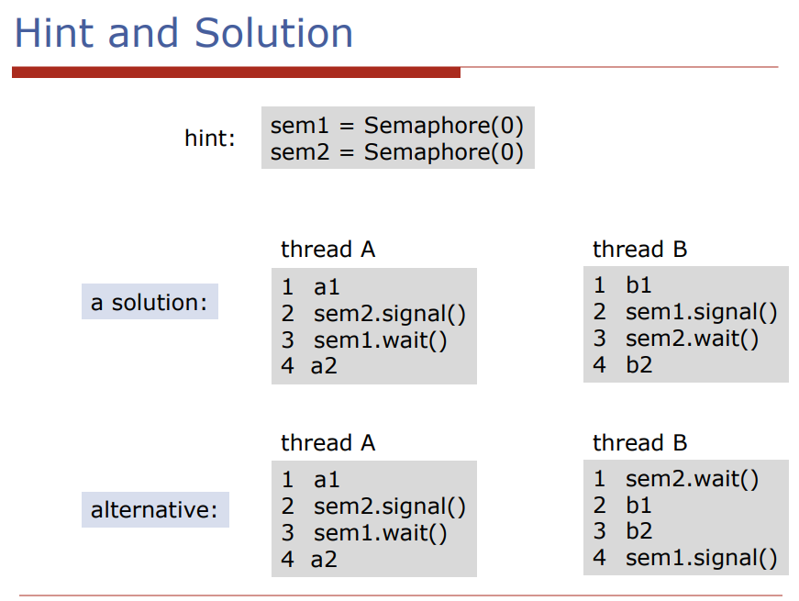

Slide 12
Create a global bash variable foo and set it equal to the string “bar”.
export foo=”bar”

Slide 13
Assign the output of the command date to a variable x.
x=$(date)

Slide 14
Create an alias called clr for the clear command.
alias clr=”clear”

Slide 15
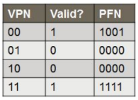
Suppose:
simple paging scheme
virtual address space of 1k
a physical address space of 4k
page size of 256.
Using the page table, what is the physical address corresponding to the virtual address 00 0111 1101?

Slide 16
Suppose:
there are 10 bits in the VPN part of a virtual address
the size of a page is 4 KB
What is the total size of the virtual address space?
2^22 bytes

Slide 17
Suppose:
- there are 1024 pages in the virtual address space
- the size of a page is 1 KB
How many bits in a virtual address?
2^20 bytes

Slide 18
Suppose:
- number of bits in a virtual address is 14
- there are 64 pages in the virtual address space
How many bytes in a page?
2^8 bytes

Slide 19
Suppose:
- size of virtual address space is 64 bytes
- number of pages is 4
How many bits in the offset part of a virtual address?
4 bits

Slide 20
Using awk, output the number of lines in temp.txt that have exactly three fields.
awk ‘{if (NF == 3) n++} END { print n}’ temp.txt

Slide 21
Write a standalone awk script that prints the sum of the values in field 5, only add field 5 to the sum if field 4 is greater than 0.
{
if ($4 > 0) total += $5
}
END { print total}

Slide 22
Five jobs, A through E arrive at the same time. They have estimated running times of 12, 10, 2, 4, and 7 minutes. Determine the average turnaround time for round robin scheduling.
24.6 min

Slide 23
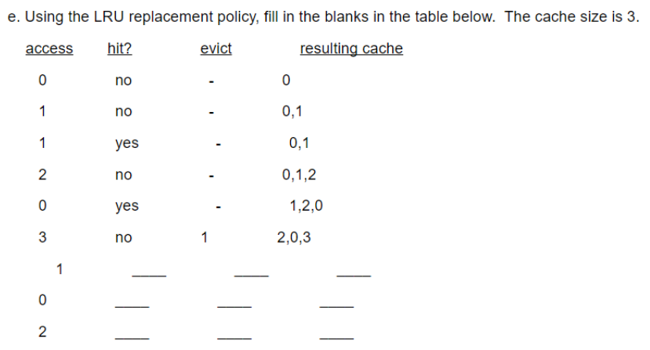

Slide 24
Delete all the C files in the current directory
List all files in the current directory including hidden files and save the output to foo.txt
rm *.c
ls -a > foo`.txt

Slide 25
Print all the C files in the current directory
List all C files in the directories below the current directory
for i in *.c; do echo $i; done
ls */*.c

Slide 26
A = 20, B = 5, C = 10
We have three jobs A, B, and C. If we run the jobs in the following order:
C -> B -> A
What will be the average turnaround time?
What order would we use to achieve the best turnaround time?
20
BCA

Slide 27
Show the first 7 lines of the file bar
Create a tar file named hw1.tar from a folder called homework1 in your current directory
head -7 bar
tar cf hw1.tar homework1

Slide 28
Expand the archive file ‘hw1.tar’ in your current working directory
Compress file ‘msh.tar’.
tar xf hw1.tar
gzip msh.tar

Slide 29
A = 5, B = 5, C = 12
We have three jobs A, B, and C. Let’s assume all three jobs arrive at the same time:
What is the average turnaround time using Round Robin Scheduling?
What is the average turnaround time using Shortest Job First?
What is the average response time?
17.3
12.3
5

Slide 30
Uncompress file ‘msh.tar.gz’
List all the files in the current directory, sort them, and output the results to a file called sorted.txt
gunzip msh.tar.gz
ls | sort > sorted.txt

Slide 31
If a ‘fork’ call returns a value of 0 which process do we have?
About how long does it take to access a file stored on a hard drive?
child process
10 ms

Slide 32
Change the file foo.txt to give the owner read, write, and execute permissions, give the group and others read permissions.
Change the file bar.txt so that only the owner can read and write.
chmod 744 foo.txt
chmod 600 bar.txt

Slide 33
What does the command ‘ls foo.txt 2> temp.txt’ do?
What does the comand ‘head -5 foo.txt >> temp.txt’ do?
Outputs any errors to temp.txt
Appends the output to temp.txt

Slide 34
Thank you for coming to my TED Talk!

